Slide 1
Analysis of User Behavior for Twitter Posts on Hadoop
- Abhilash Saj

Slide 2
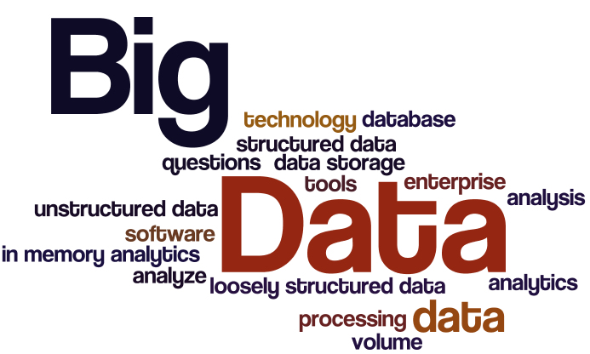
INTRODUCTION
Big Data refers to collection of large datasets containing massive amount of data whose size is in the range of Petabytes, Zettabytes, or with high rate of growth, and complexity that make them difficult to process and analyse using conventional database technologies.

Slide 3
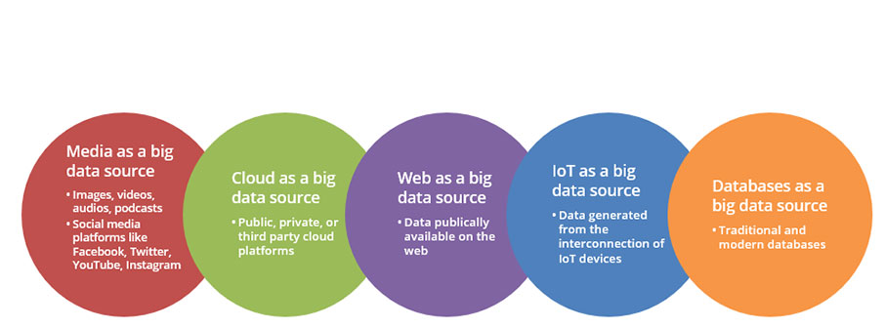
SOURCES OF BIG DATA

